Slide 1

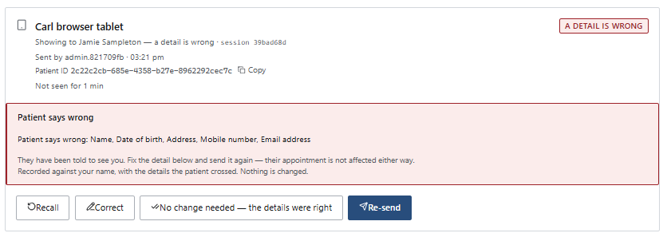
Have a link here to go to the error so a better solution

Slide 2
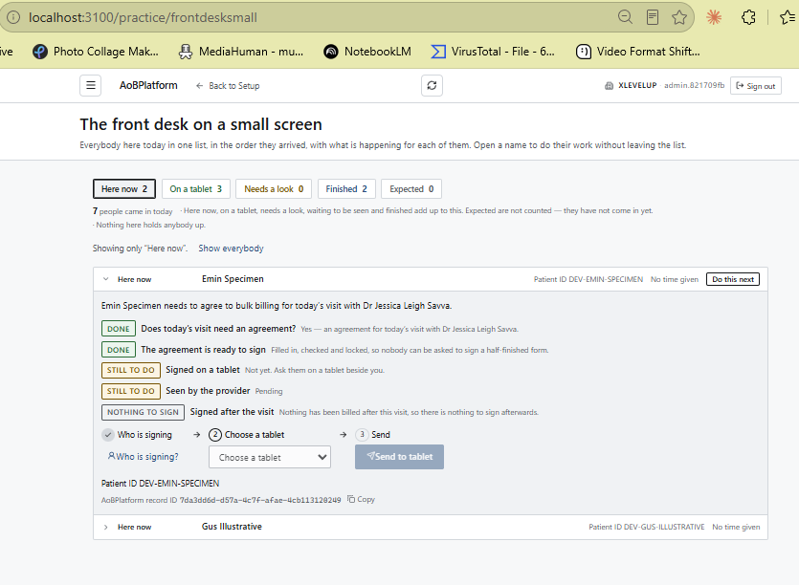
Put tags in col 1 – left aligned.
Put text in col 2 left aligned
Should say (enduring / episodic) at least while we are testing

Slide 3
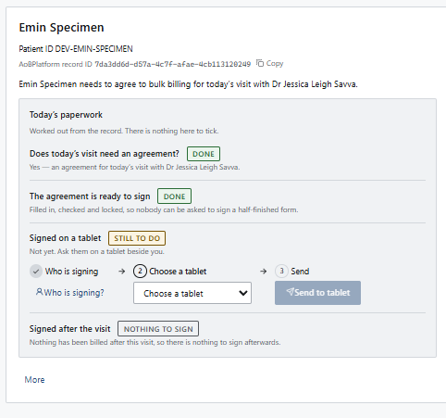
Note: if the patient has to see a nurse or do bloods then these will also be steps here before the patient goes to the “Finished List”.
Also, if the patient has to see another doctor in the practice and that doctor is a specialist then the patient will need to added to the Queue again and assigned to the specialist with the episodic agreement process.
Insert step : Consultation completed

Slide 4
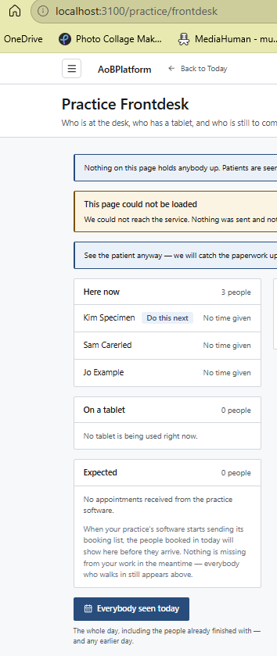
Make the font bold and a diff colour for the number – so it stands out

Slide 5
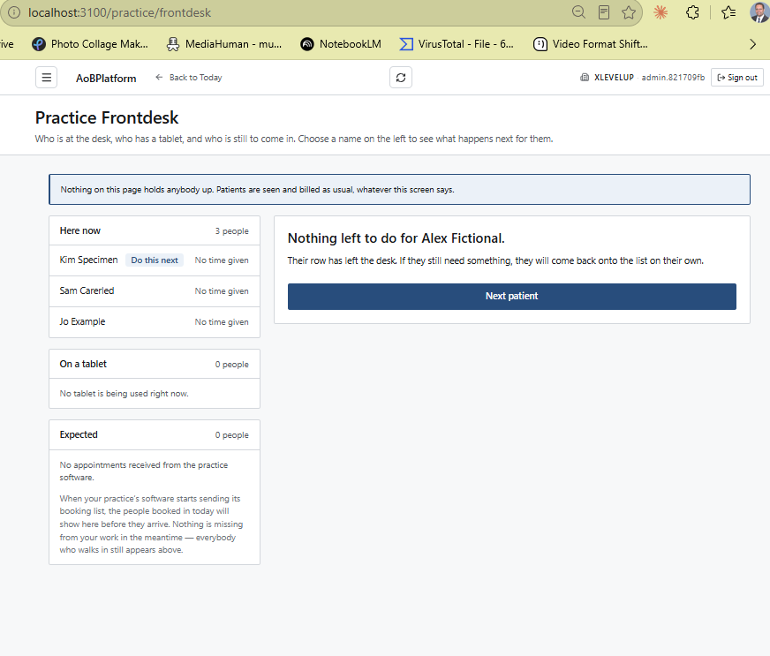
Add a button here with a link to show all Patients seen at this practice today.
You could put a filter on this to search for any day. Default to today.

Slide 6
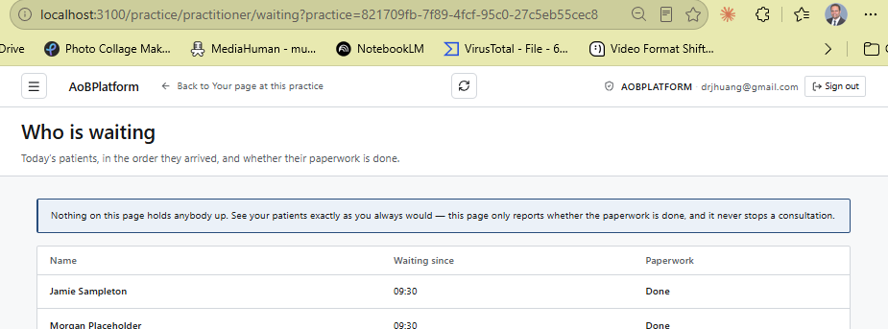
AOBPLATFORM should actually say the PracticeName the Practioner is workin at
Patients waiting for consultation

Slide 7
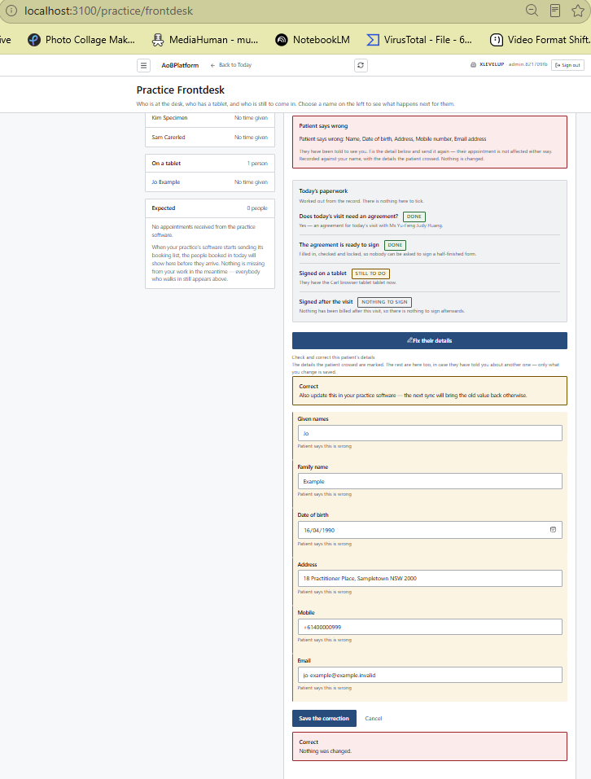
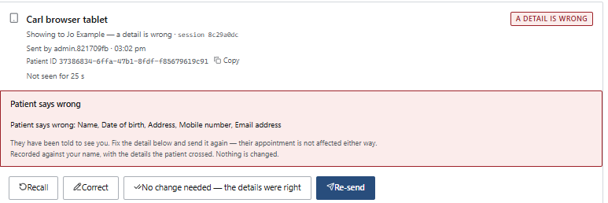

After send to tablet it should show. See page practice/tablet for how to do this. Why are you not just copying the existing logic.
Also:
Jo example was sent to the “Carls browser tablet” from practice/tablet
However on practice/frontdesk jo example did not change to reflect this status.
Need the same buttons

Slide 8
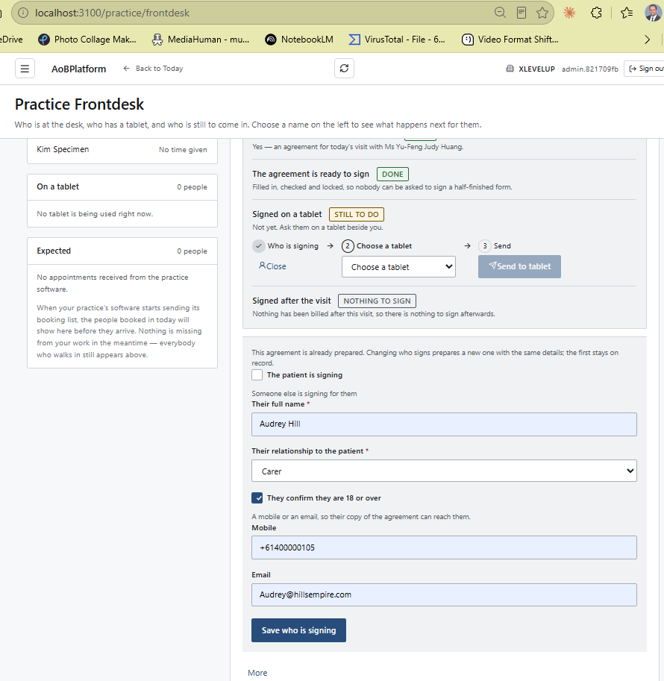
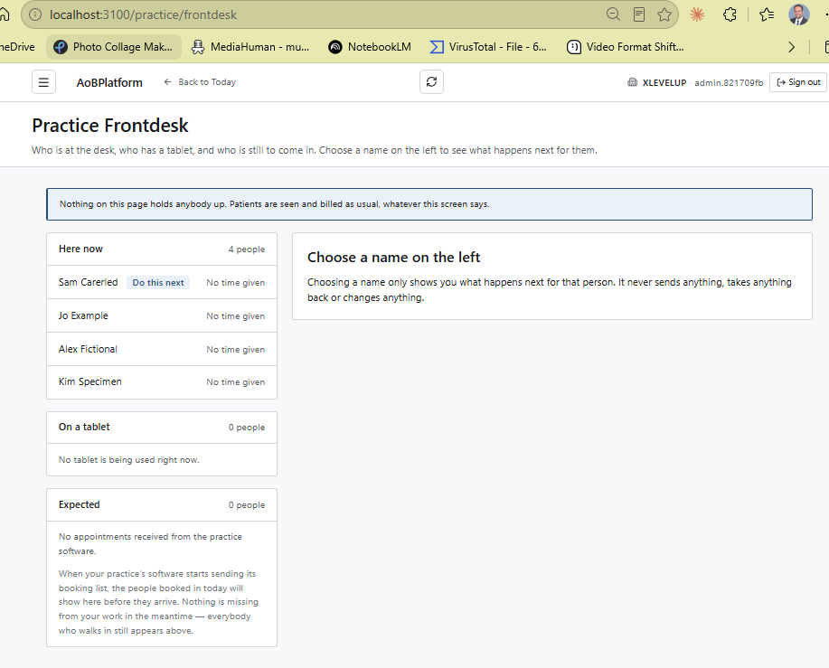
On pressing Save who is signing – gives s 65 error and then goes to the view on the right.

Slide 9
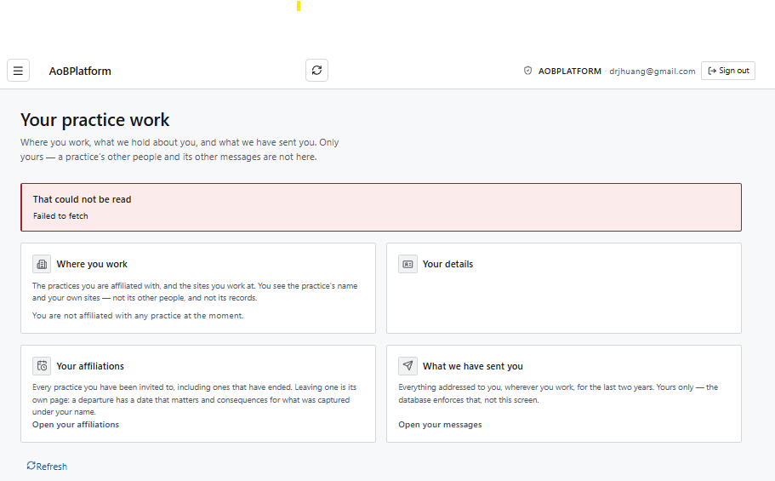
AOBPLATFORM should actually say the PracticeName the Practioner is workin at

Slide 10
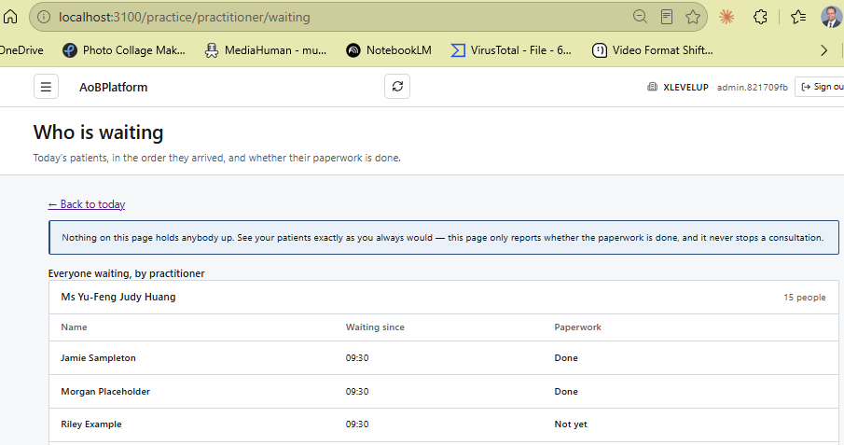
For the current build without these changes – this page works great for all practice users except the practice-practioners.
For Practitioners we only want to show the queue for the practioner at the practice the practitioners is working at.
Yes, this means that if a practioner is working at 3 practices, the practioner will have 3 logins one for each practice. Add to to todo to review this design decision later.
Need buttons or drop down to say
With patient now
Pending (patient in queue)
Completed (consultation completed)
Reassign (to a different Doctor) – Reception will have a task on the frontdesk/patient page to reassign the patient to different doctor and do the necessary checks and so on.
Make bold and larger font

Slide 11
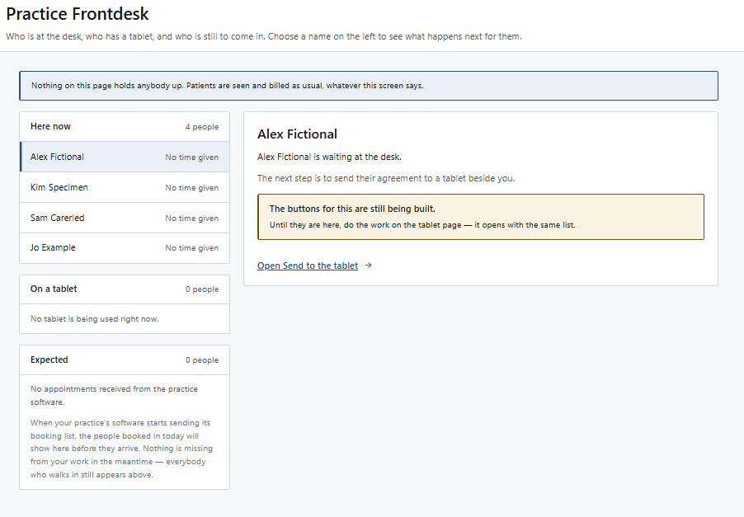
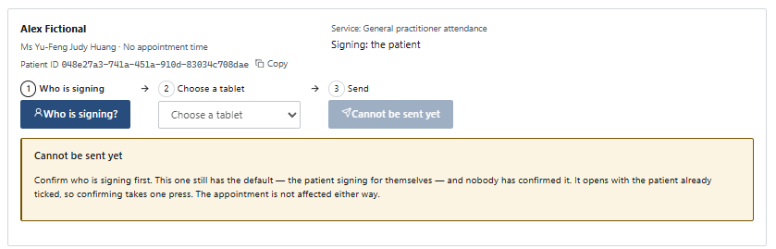
What we want here is a list of all services to the patient on today’s visit (this is the per patient workflow)
Check patient needs enduring/episodic agreement approved
Create agreement
Get patient to approve on tablet
Patient to see doctor
Patient to do a Blood Test
Patient to see Nurse – for something
Patient to approve post all the above the post-episodic agreement
Patient to make payment (mostly for specialist – episodic agreements)
… your thoughts claude.
We need to track that these steps have been completed. So when the Dr has seen the patient the dr will flag their card as complete. The nurse and the blood-test will do the same. This list will then change to a tick next to the item in the list or a Completed (was pending) tag.
Below this list we have the actions like getting the patient to approve and so on.
Your thoughts.
This card should appear when the reception-user selects – for step 3 - Get patient to approve on tablet

Slide 12
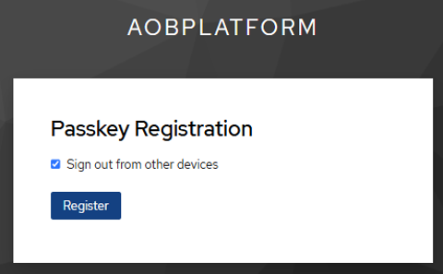
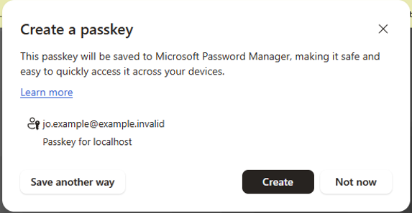
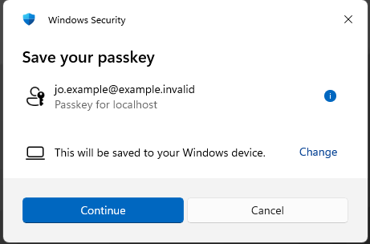
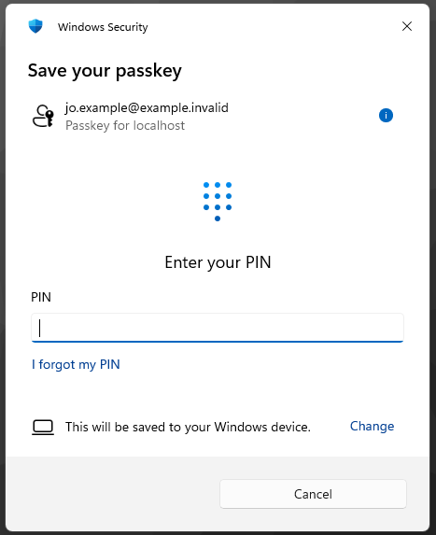
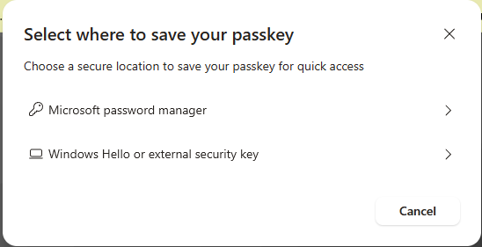
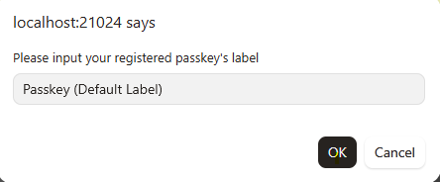
We need to put in a side panel or somewhere on the page next to the “Passkey Registration” box the steps to follow for a windows machine. We will need to do the same for Apple PC, Android and Apple mobile

Slide 13
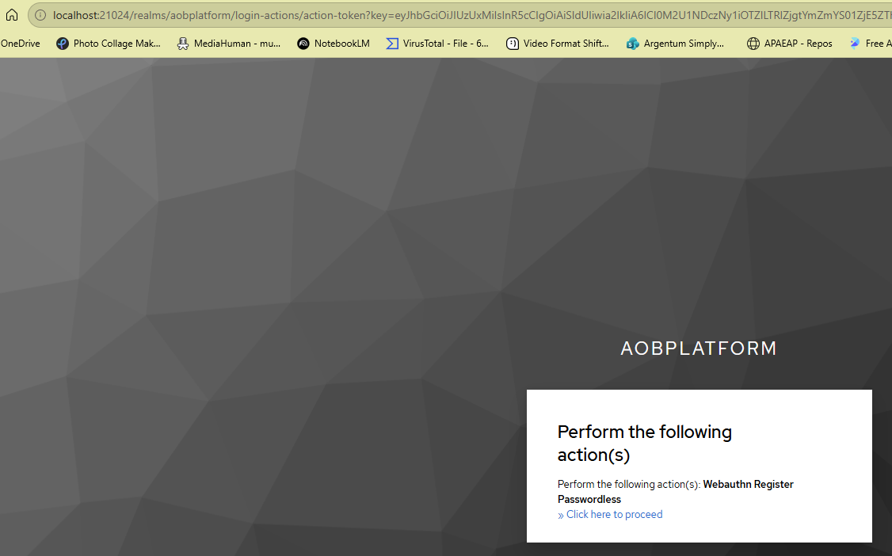
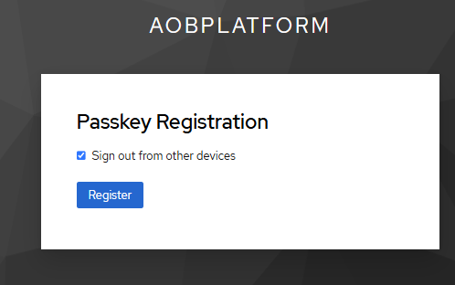
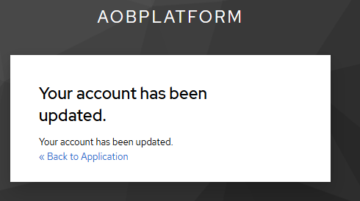
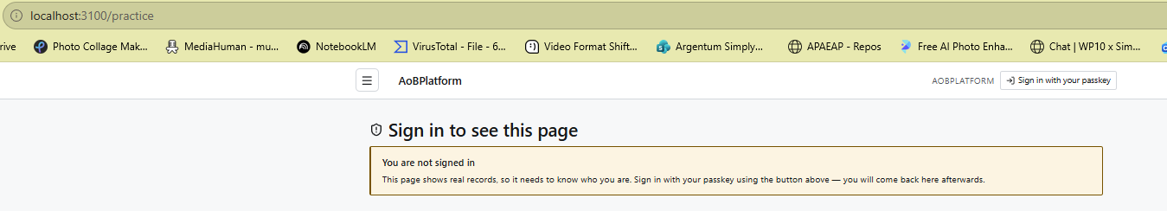
This is jo.example just setup, but went to practice

Slide 14
Welcome
Welcome
Ask for medicare card. Ask the customer their name and what their number is on the medicare card. Enter the customer name into the AoBPlatform and check that the customer name match to the medicare card.

Slide 15
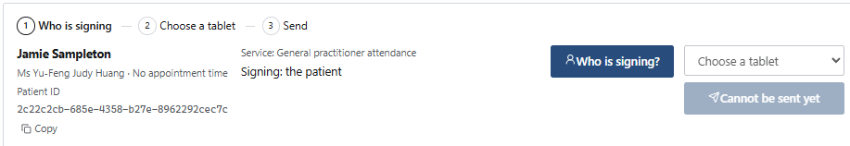






Slide 16
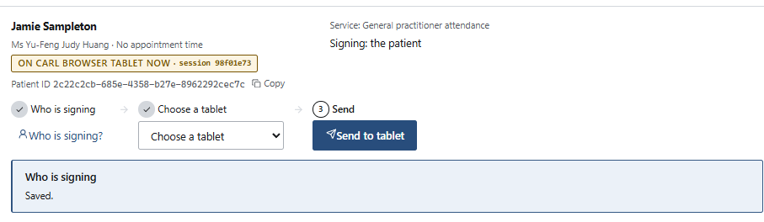


Slide 17
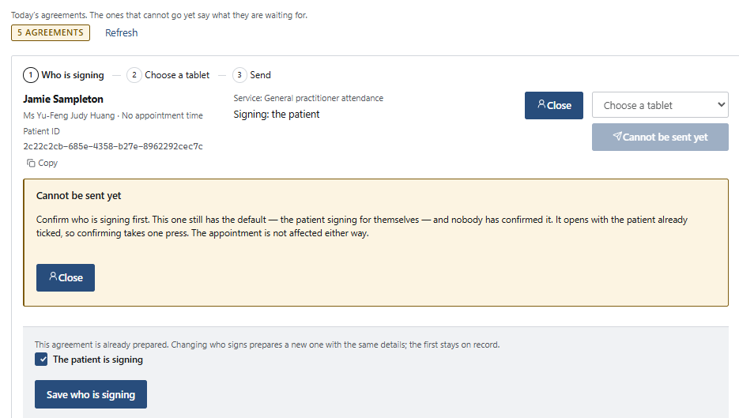

Slide 18
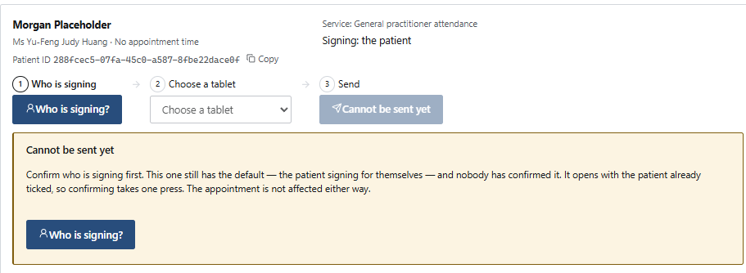
X

Slide 19
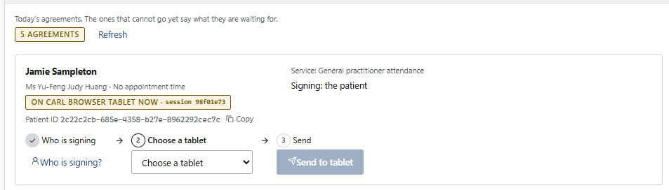

X

Slide 20
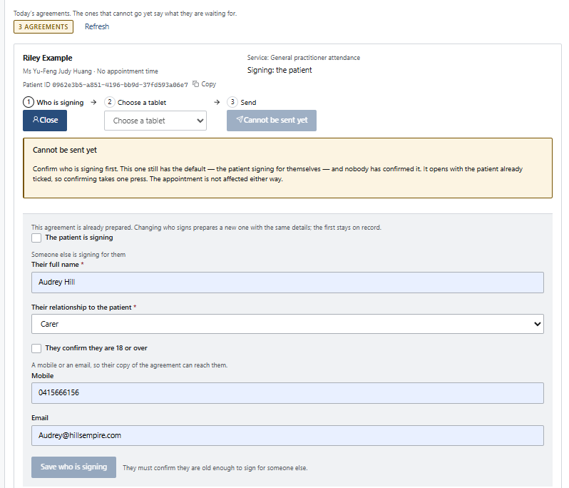
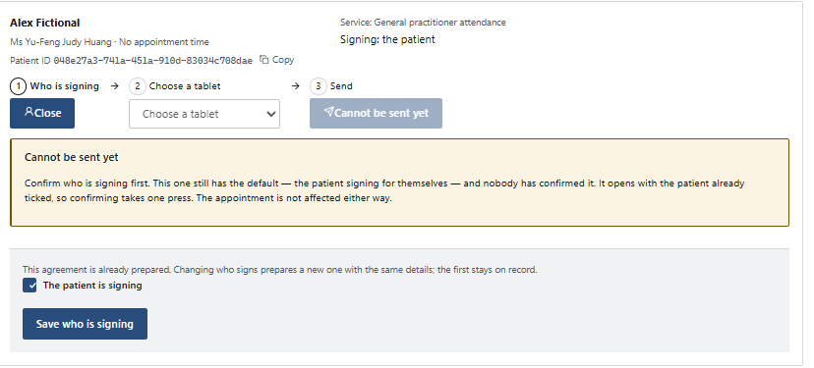
Click – who is signing and it is the carer. Press save who is signing.
Then go back to who is signing and the carer details are lost.

